Slide 1
Credit Card Default Case Study Part A
Data Mining I
DHEERA KUMAR

Slide 2
What is the Credit Card Default dataset, and its history?
A study was conducted in Taiwan named “The comparisons of data mining techniques for the predictive accuracy of probability of default of credit card clients”
This research aimed at the case of customers’ default payments in Taiwan and compares the predictive accuracy of probability of default.
The study took payment data in October 2005, from an important bank (a cash and credit card issuer) in Taiwan, and the targets were credit card holders of the bank.
This research employed a binary variable – default payment (Yes = 1, No = 0), as the response variable.
The past monthly payment records (from April to September 2005), the amount of bill statement, and sever other demographic features were captured for each customer.
This dataset has 30,000 records

Slide 3
What information does this dataset contain? – part 1
There are 25 attributes for each row of the dataset:
ID - ID of each client
LIMIT_BAL - Amount of given credit in NT dollars (includes individual and family/supplementary credit.
SEX - Gender (1=male, 2=female)
EDUCATION - (1=graduate school, 2=university, 3=high school, 4=others, 5=unknown, 6=unknown)
MARRIAGE - Marital status (1=married, 2=single, 3=others)
AGE - Age in years
PAY_0 - Repayment status in September, 2005 (-1=pay duly, 1=payment delay for one month, 2=payment delay for two months, ..., 9=payment delay for nine months and above)
PAY_2 - Repayment status in August, 2005 (scale same as above)
PAY_3 - Repayment status in July, 2005 (scale same as above)SEX - Gender (1=male, 2=female)
PAY_4 - Repayment status in June, 2005 (scale same as above)
PAY_5 - Repayment status in May, 2005 (scale same as above)
PAY_6 - Repayment status in April, 2005 (scale same as above)
BILL_AMT1 - Amount of bill statement in September, 2005 (NT dollar)

Slide 4
What information does this dataset contain? – part 2
BILL_AMT2 - Amount of bill statement in August, 2005 (NT dollar)
BILL_AMT3 - Amount of bill statement in July, 2005 (NT dollar)
BILL_AMT4 - Amount of bill statement in June, 2005 (NT dollar)
BILL_AMT5 - Amount of bill statement in May, 2005 (NT dollar)
BILL_AMT6 - Amount of bill statement in April, 2005 (NT dollar)
PAY_AMT1 - Amount of previous payment in September, 2005 (NT dollar)
PAY_AMT2 - Amount of previous payment in August, 2005 (NT dollar)
PAY_AMT3 - Amount of previous payment in July, 2005 (NT dollar)
PAY_AMT4 - Amount of previous payment in June, 2005 (NT dollar)
PAY_AMT5 - Amount of previous payment in May, 2005 (NT dollar)
PAY_AMT6 - Amount of previous payment in April, 2005 (NT dollar)
default.payment.next.month Default payment (1=yes, 0=no)

Slide 5
Some basic statistics on dataset features – part 1
Feature name | Any nulls? | # of rows | Min value | Max value | Average | 75th %ile
LIMIT_BAL | No | 30000 | 10000 | 1000000 | 167484.32 | 240000
SEX | No | 30000 | 1 | 2 | 1.60 | 2
EDUCATION | No | 30000 | 0 | 6 | 1.85 | 2
MARRIAGE | No | 30000 | 0 | 3 | 1.55 | 2
AGE | No | 30000 | 21 | 79 | 35.48 | 41
PAY_0 | No | 30000 | -2 | 8 | -0.01 | 0
PAY_2 | No | 30000 | -2 | 8 | -0.13 | 0
PAY_3 | No | 30000 | -2 | 8 | -0.16 | 0
PAY_4 | No | 30000 | -2 | 8 | -0.22 | 0
PAY_5 | No | 30000 | -2 | 8 | -0.26 | 0
PAY_6 | No | 30000 | -2 | 8 | -0.29 | 0
BILL_AMT1 | No | 30000 | -165580 | 964511 | 51223.33 | 67091
BILL_AMT2 | No | 30000 | -69777 | 983931 | 49179.07 | 64006.25
BILL_AMT3 | No | 30000 | -1.57e+05 | 1.66e+06 | 4.70e+04 | 6.01e+04

Slide 6
Some basic statistics on dataset features – part 2
Feature name | Any nulls? | # of rows | Min value | Max value | Average | 75th %ile
BILL_AMT4 | No | 30000 | -170000 | 891586 | 43262.94 | 54506
BILL_AMT5 | No | 30000 | -81334 | 927171 | 40311.40 | 50190.50
BILL_AMT6 | No | 30000 | -339603 | 961664 | 38871.76 | 49198.25
PAY_AMT1 | No | 30000 | 0 | 873552 | 5663.58 | 5006
PAY_AMT2 | No | 30000 | 0 | 1.68e+06 | 5.92e+03 | 5e+03
PAY_AMT3 | No | 30000 | 0 | 896040 | 5225.68 | 4505.50
PAY_AMT4 | No | 30000 | 0 | 621000 | 4826.07 | 4013.25
PAY_AMT5 | No | 30000 | 0 | 426529 | 4799.38 | 4031.50
PAY_AMT6 | No | 30000 | 0 | 528666 | 5215.50 | 4000
default_payment_next_month | No | 30000 | 0 | 1 | 0.22 | 0

Slide 7
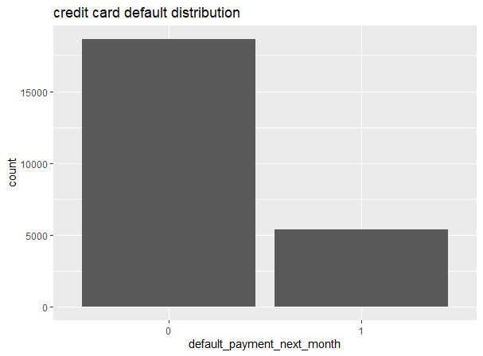
Data exploration on 80% Training data – Analyzing Target variable distribution
The train dataset contains 80% of the rows sampled randomly with a given seed 14283873. Let’s analyze the target variable:
In this dataset, ~18,000 have the credit default value 0, and only ~5000 people have a default value 1.
This implies there are few people who could default on their credit card payment.

Slide 8

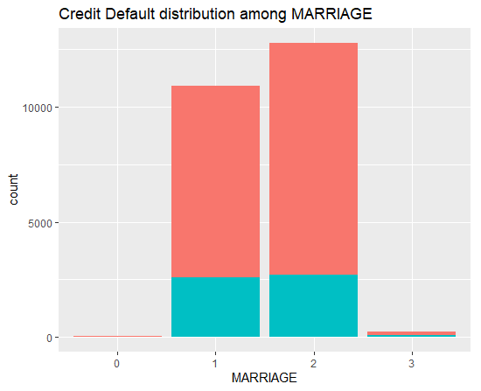
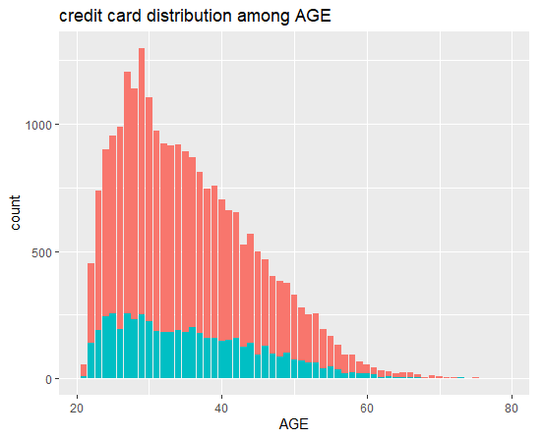
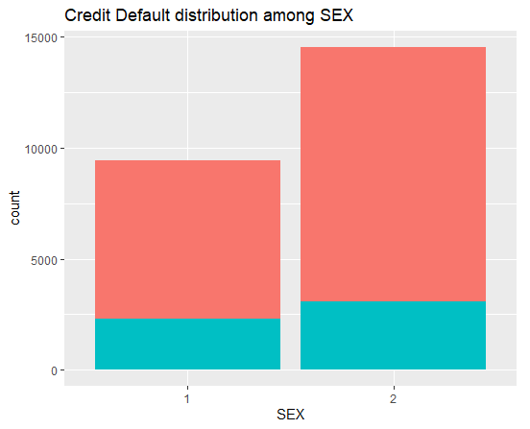
Data exploration on 80% Training data – Analyzing other variable distributions
Let’s analyze the distribution of other important demographic features such as marriage, age and sex.

Slide 9
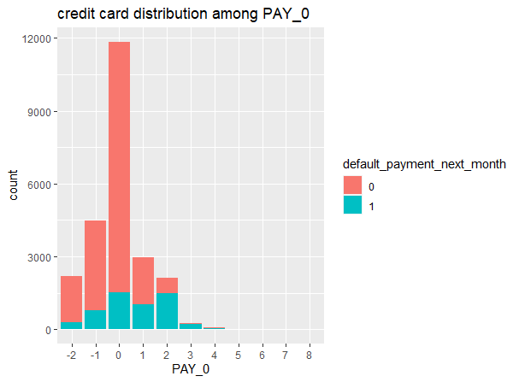
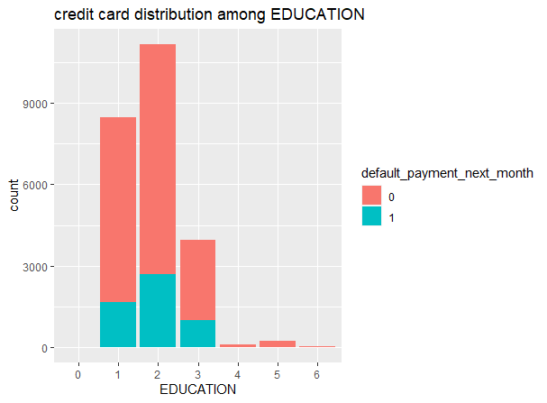
Data exploration on 80% Training data – Plotting a regression line on RM and LSTAT
Analyzing the relationship between 2 highly correlated features – PAY_0 and EDUCATION

Slide 10
Conducting Logistic Regression on 80% training data
Full model: In this model we choose all the predictor variables, and then try to predict the credit default value.
AIC | BIC | # of variables | Mean Residual Deviance
20997.55 | 21668.67 | 23 | 0.8709
Null model: In this model we do not take any predictor variables, and then try to predict the credit default value.
AIC | BIC | # of variables | Mean Residual Deviance
25497.03 | 25505.12 | 0 | 1.0623
Two variable model: In this model we take EDUCATION and PAY_0 as predictor variables, and then try to predict the credit default value.
AIC | BIC | # of variables | Mean Residual Deviance
21741.37 | 21878.82 | 2 | 0.9051

Slide 11
Variable Selection – Stepwise selection with AIC, BIC
Selection using AIC:
In this selection, the lowest AIC score obtained is 20991.88, and total variables selected are 19
Final variables selected are as follows:
PAY_0 + PAY_3 + LIMIT_BAL + PAY_5 + PAY_AMT1 + MARRIAGE + EDUCATION + BILL_AMT2 + PAY_6 + PAY_4 + PAY_AMT2 + SEX + PAY_2 + PAY_AMT5 + PAY_AMT3 + PAY_AMT6 + AGE + BILL_AMT1 + BILL_AMT3
Selection using BIC:
In this selection, the lowest BIC score obtained is 21385.83, and total variables selected are 9
Final variables selected are as follows:
PAY_0 + LIMIT_BAL + PAY_5 + PAY_AMT2 + PAY_AMT1 + BILL_AMT3 + MARRIAGE + SEX + PAY_AMT3
AIC | BIC | # of variables | Mean Residual Deviance
20991.88 | 21630.66 | 19 | 0.8709
AIC | BIC | # of variables | Mean Residual Deviance
21151.34 | 21385.83 | 9 | 0.8799

Slide 12
Conducting LASSO Variable Selection – With Lambda.min and Lambda.1se
Using lambda.min as optimal λ:
The total variables selected by the model are 23
Final variables selected are as follows:
LIMIT_BAL + SEX + EDUCATION + MARRIAGE + AGE + PAY_0 + PAY_2 + PAY_3 + PAY_4 + PAY_5 +PAY_6 + BILL_AMT1 + BILL_AMT2 + BILL_AMT3 + BILL_AMT4 + BILL_AMT5 + BILL_AMT6 + PAY_AMT1 + PAY_AMT2 + PAY_AMT3 + PAY_AMT4 + PAY_AMT5 + PAY_AMT6
Using lambda.1se as optimal λ:
The total variables selected by the model are 17
Final variables selected are as follows:
LIMIT_BAL + SEX + EDUCATION + MARRIAGE + AGE + PAY_0 + PAY_2 + PAY_3 + PAY_4 + PAY_5 +PAY_6 + PAY_AMT1 + PAY_AMT2 + PAY_AMT3 + PAY_AMT5 + PAY_AMT6
AIC | BIC | # of variables | Mean Residual Deviance
20997.55 | 21668.67 | 23 | 0.8709
AIC | BIC | # of variables | Mean Residual Deviance
21023.12 | 21637.65 | 17 | 0.8723

Slide 13
Summary Table
Method | Selected Variables | Model Mean Residual Deviance (in-sample)
Null Model | 1 | 1.0623
Full Model | . | 0.8709
Two-variable model | EDUCATION + PAY_0 | 0.9051
Stepwise (BIC) | PAY_0 + LIMIT_BAL + PAY_5 + PAY_AMT2 + PAY_AMT1 + BILL_AMT3 + MARRIAGE + SEX + PAY_AMT3 | 0.8799
Stepwise (AIC) | PAY_0 + PAY_3 + LIMIT_BAL + PAY_5 + PAY_AMT1 + MARRIAGE + EDUCATION + BILL_AMT2 + PAY_6 + PAY_4 + PAY_AMT2 + SEX + PAY_2 + PAY_AMT5 + PAY_AMT3 + PAY_AMT6 + AGE + BILL_AMT1 + BILL_AMT3 | 0.8709
LASSO (lambda.min) | LIMIT_BAL + SEX + EDUCATION + MARRIAGE + AGE + PAY_0 + PAY_2 + PAY_3 + PAY_4 + PAY_5 +PAY_6 + BILL_AMT1 + BILL_AMT2 + BILL_AMT3 + BILL_AMT4 + BILL_AMT5 + BILL_AMT6 + PAY_AMT1 + PAY_AMT2 + PAY_AMT3 + PAY_AMT4 + PAY_AMT5 + PAY_AMT6 | 0.8709
LASSO (lambda.1se) | LIMIT_BAL + SEX + EDUCATION + MARRIAGE + AGE + PAY_0 + PAY_2 + PAY_3 + PAY_4 + PAY_5 +PAY_6 + PAY_AMT1 + PAY_AMT2 + PAY_AMT3 + PAY_AMT5 + PAY_AMT6 | 0.8723

Slide 14
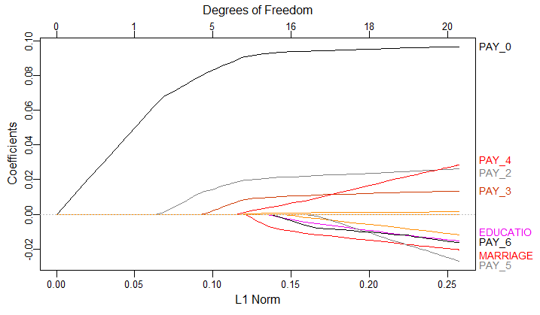
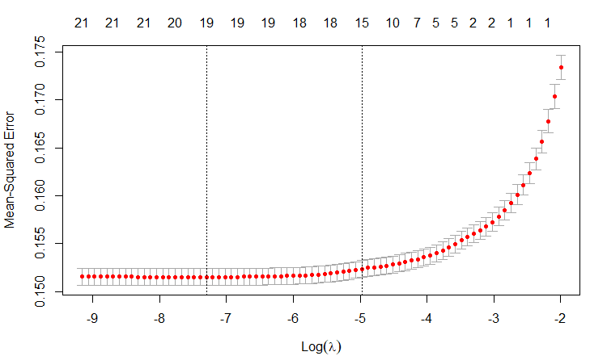
Figure of LASSO variable selection
Final model selection - Stepwise(BIC) is the model I will choose. It has a least comparable Mean Residual Deviation, and with just 9 variables, it helps in reducing model complexity drastically.
Plotting 8 best variables
Using 5-fold cross validation to get best lambda

Slide 15
Credit Card Default Case Study Part AB
Data Mining I
DHEERAJ KUMAR

Slide 16
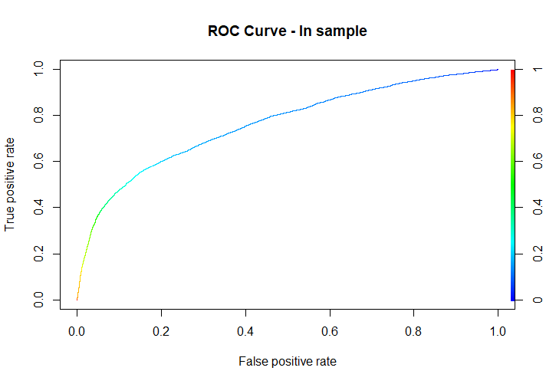
In-sample Testing with best model
 | Predicted | Predicted
Actual |  | 0 | 1
Actual | 0 | 17729 | 910
 | 1 | 3407 | 1954
AUC Score – 0.763
Misclassification table
Cut off prob – 1/2
Symmetric score – 0.179
 | Predicted | Predicted
Actual |  | 0 | 1
Actual | 0 | 12879 | 5760
 | 1 | 1678 | 3683
Misclassification table
Cut off prob – 1/6
Asymmetric score – 0.589

Slide 17

Out-of-sample Testing with best model
 | Predicted | Predicted
Actual |  | 0 | 1
Actual | 0 | 4476 | 249
 | 1 | 802 | 473
AUC Score – 0.757
Misclassification table
Cut off prob – 1/2
Symmetric score – 0.175
 | Predicted | Predicted
Actual |  | 0 | 1
Actual | 0 | 3201 | 1524
 | 1 | 375 | 900
Misclassification table
Cut off prob – 1/6
Asymmetric score – 0.565

Slide 18
Cross validation and Summary Table
Parameters | Cross validation = 5 | Out-of-sample
AUC | 0.606 | 0.757
Asymmetric cost | 0.862 | 0.565
We notice that the AUC score for full model with cross validation is less as compared to out-of-sample AUC. This might be because in the full model we are taking all the variables (both good and bad) which leads to less AUC score. Whereas for out-of-sample, the model is trained with Stepwise-BIC and has only the best variables.
Random Seed (80%/20%) | AUC (in-sample) | AUC (out-of-sample) | Asy. Cost (in-sample) | Asy. Cost (out-of-sample) | 5-fold CV (AUC) | 5-fold CV (Asym. Cost)
M# | 0.763 | 0.757 | 0.589 | 0.565 | - | -
Full | 0.607 | - | 0.861 | - | 0.606 | 0.862

Slide 19
Credit Card Default Case Study Part ABC
Data Mining I
DHEERAJ KUMAR

Slide 20
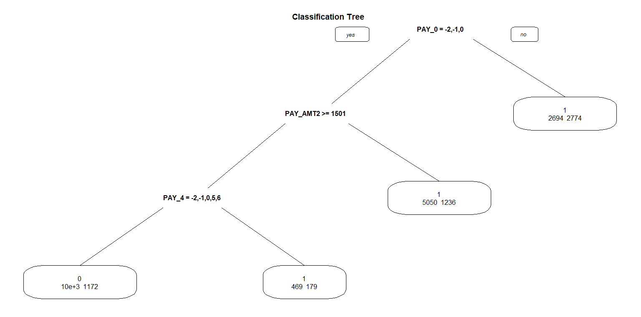
Classification Tree
We first evaluate using a default cp value of 0.001, to see how our tree sizes are getting impacted.
From the observed plot, we can see that at tree size = 5, the relative error goes below the mean. Hence, we choose the number of trees to be 5 in this case. The corresponding cp value is 0.016

Slide 21
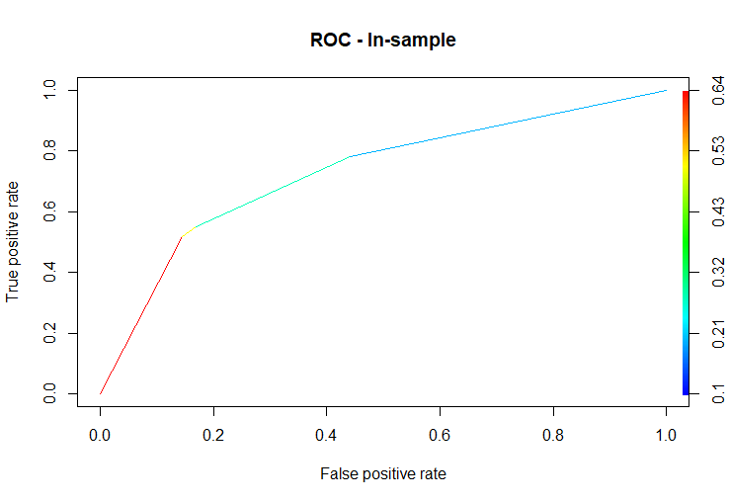
Classification Tree – In Sample
AUC score for out-of-sample: 0.729
Misclassification table
Cut off prob – 1/6
Asymmetric score – 0.589
 | Predicted | Predicted
Actual |  | 0 | 1
Actual | 0 | 12852 | 5787
 | 1 | 1670 | 3691

Slide 22
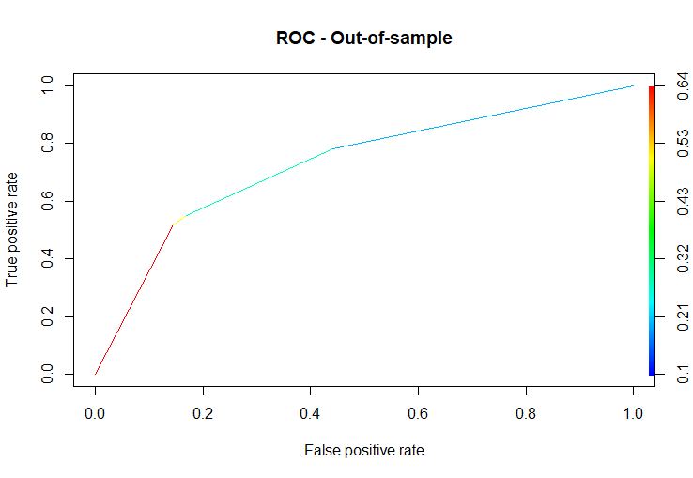
Classification Tree – Out of Sample
AUC score for out-of-sample: 0.725
Misclassification table
Cut off prob – 1/6
Asymmetric score – 0.686
 | Predicted | Predicted
Actual |  | 0 | 1
Actual | 0 | 2615 | 2110
 | 1 | 280 | 995

Slide 23
Cross validation and Summary Table
Random Seed (80%/20%) | Method “best” | AUC (in-sample) | AUC (out-of-sample) | Asy. Cost (in-sample) | Asy. Cost (out-of-sample) | 5-fold CV (AUC) | 5-fold CV (Asym. Cost)
M# | Logistic | 0.763 | 0.757 | 0.589 | 0.565 | - | -
 | Classification Tree | 0.729 | 0.725 | 0.681 | 0.686 | - | -
Full | Logistic | 0.607 | - | 0.861 | - | 0.606 | 0.862
 | Classification Tree | 0.728 | - | 0.682 | - | - | -

